Slide 1
TECHNICAL DEBT

Slide 2
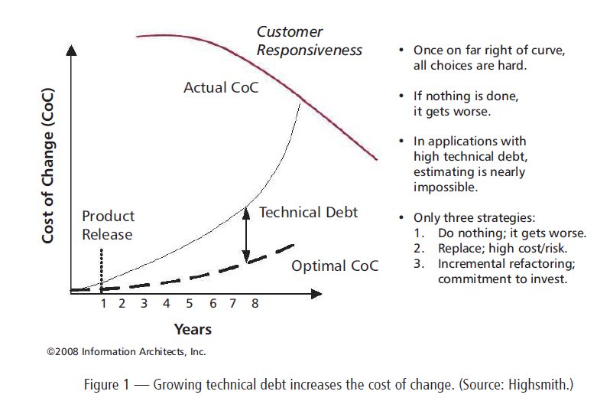

Slide 3
TYPES OF TECHNICAL DEBT
Lack of automated testing
Code that is unnecessarily coupled.
Escalating code complexity.
Duplicate code.

Slide 4
You can also categorize debt by the mentality of the team that introduced it!!!!!!!
Were you deliberately introducing the technical debt, or did it happen inadvertently? Was it a result of being reckless or prudent?
Reckless and inadvertent (“What’s layering?”)
Reckless and deliberate (“We don’t have time for design.”)
Prudent and inadvertent (“Now we know how we should have done it.”)
Prudent and deliberate (“We must ship now and deal with the consequences.”)

Slide 5
THE COST OF TECHNICAL DEBT
The cost of technical debt can be broken down three ways as follows:
Principal. This is the amount of effort in dollars that it would take to fully service the technical debt.
2. Recurring interest. This is the cost to the organization for holding onto the debt
3. Compounding interest. This is the additional technical debt that accrues over time.

Slide 6
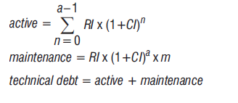

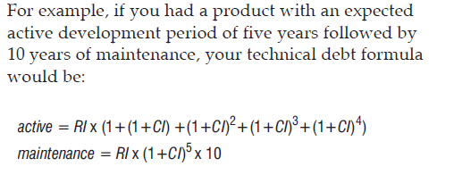
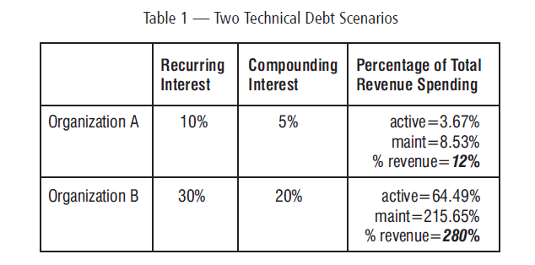
Technical Debt Calculation

Slide 7
A technical debt payment plan can be set up by
1. Putting in place a continuous build that fails on technical debt increases
2. Adding refactoring tasks to stories requested in areas of high technical debt
3. Slowing down the team velocity to a sustainable pace at which technical debt can be serviced

Slide 8
Technical debt reduction activities
Stakeholder prioritized.
Fixed allocation.
GOOD TECHNICAL DEBT
It has a low interest rate.
It is being regularly serviced.
The work that preceded it had a very high opportunity cost.

